Slide 1
Consistency and Replication

Slide 2
Interprocess Communication
Shared Memory,
Message Passing Paradigm

Slide 3
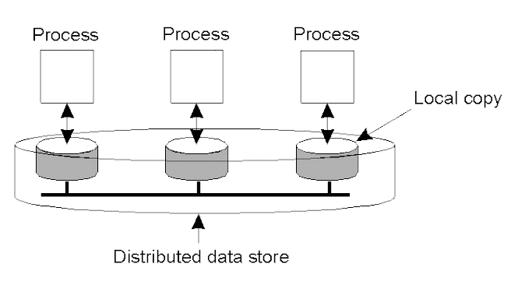
Data-Centric Consistency Models
The general organization of a logical data store, physically distributed and replicated across multiple processes.

Slide 4
Design and Implementation issues of DSM
Granularity
Structure of shared –memory space
Memory Coherence and Access Synchronization
Data Location and access
Replacement strategy
Thrashing
Heterogeneity

Slide 5

Strict Consistency
Any read on a data item x returns a value corresponding to the results
of the most recent write on x
Behavior of two processes, operating on the same data item.
A strictly consistent store.
A store that is not strictly consistent.

Slide 6

Sequential Consistency (1/single copy)
The result of any execution is the same as if the read and the write
Operations by all processes on the data store were executed in some
Sequential order and the operations of each individual process appear
in this sequence in the order specified by its program.
A sequentially consistent data store.
A data store that is not sequentially consistent.

Slide 7
Linearizability Consistency (2)
The result of any execution is the same as if the read and the write
Operations by all processes on the data store were executed in some
Sequential order and the operations of each individual process appear
in this sequence in the order specified by its program.
In addition, if ts OP1(x) < ts OP2(y), then operation OP1(x) should
Precede OP(y) in this sequence.

Slide 8
Causal Consistency (1)
Necessary condition: Writes that are potentially casually related must be seen by all processes in the same order. Concurrent writes may be seen in a different order on different machines.

Slide 9

Causal Consistency (2)
This sequence is allowed with a causally-consistent store, but not with sequentially or strictly consistent store.

Slide 10

Causal Consistency (3)
A violation of a casually-consistent store.
A correct sequence of events in a casually-consistent store.

Slide 11
FIFO Consistency (1) Pipelined RAM
Necessary Condition: Writes done by a single process are seen by all other processes in the order in which they were issued, but writes from different processes may be seen in a different order by different processes.

Slide 12

FIFO Consistency (2)
A valid sequence of events of FIFO consistency

Slide 13
Weak Consistency (1)
Properties:
Accesses to synchronization variables associated with a data store are sequentially consistent.
(All processes see all ops on synch. Variable in the same process in the same order.)
No operation on a synchronization variable is allowed to be performed until all previous writes have been completed everywhere.
(Syn. Forces all writes that are in progress or partially completed at some local copies but not others to complete everywhere.)
No read or write operation on data items are allowed to be performed until all previous operations to synchronization variables have been performed.
(when a data item is accessed either for reading or for writing all the syncs. have to be completed )

Slide 14

Weak Consistency (2)
A valid sequence of events for weak consistency.
An invalid sequence for weak consistency.

Slide 15

Release Consistency (1)
A valid event sequence for release consistency.

Slide 16
Release Consistency (2)
Rules:
Before a read or write operation on shared data is performed, all previous acquires done by the process must have completed successfully.
Before a release is allowed to be performed, all previous reads and writes by the process must have completed
Accesses to synchronization variables are FIFO consistent (sequential consistency is not required).

Slide 17
Entry Consistency (1)
Conditions:
An acquire access of a synchronization variable is not allowed to perform with respect to a process until all updates to the guarded shared data have been performed with respect to that process.( At an acquire, all remote changes to the guarded data must be made visible)
Before an exclusive mode access to a synchronization variable by a process is allowed to perform with respect to that process, no other process may hold the synchronization variable, not even in nonexclusive mode. (the process should enter critical region and ensure mutual exclusion)
After an exclusive mode access to a synchronization variable has been performed, any other process's next nonexclusive mode access to that synchronization variable may not be performed until it has performed with respect to that variable's owner. (the process entering CR in non exclusive mode should check with the owner of the variable if the copy is most recent)

Slide 18

Entry Consistency (1)
A valid event sequence for entry consistency.

Slide 19
Summary of Consistency Models
Consistency | Description
Strict | Absolute time ordering of all shared accesses matters.
Linearizability | All processes must see all shared accesses in the same order. Accesses are furthermore ordered according to a (nonunique) global timestamp
Sequential | All processes see all shared accesses in the same order. Accesses are not ordered in time
Causal | All processes see causally-related shared accesses in the same order.
FIFO | All processes see writes from each other in the order they were used. Writes from different processes may not always be seen in that order
 | (a)
Consistency | Description
Weak | Shared data can be counted on to be consistent only after a synchronization is done
Release | Shared data are made consistent when a critical region is exited
Entry | Shared data pertaining to a critical region are made consistent when a critical region is entered.
 | (b)
Consistency models not using synchronization operations.
Models with synchronization operations.

Slide 20
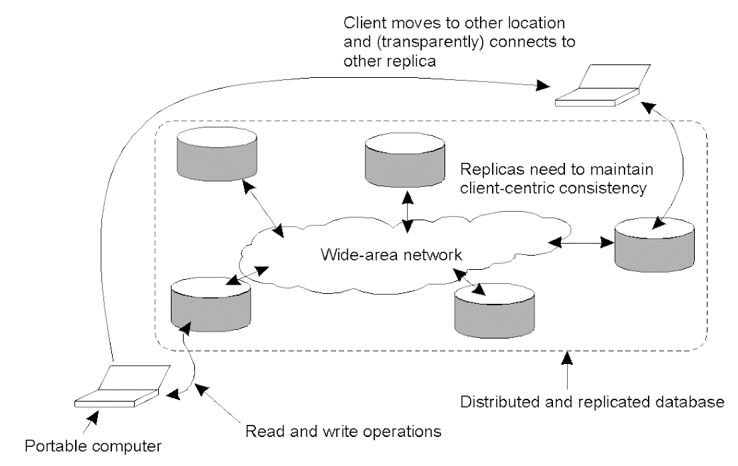
Eventual Consistency
The principle of a mobile user accessing different replicas of a distributed database.

Slide 21

Monotonic Reads
If a process reads the value of a data item x, any successive read operation on x by that process will always return that same value or a more recent value. ie. If a process has seen a value of x at time t , it will never see an older version of x at a later time.
The read operations performed by a single process P at two different local copies of the same data store.
A monotonic-read consistent data store
A data store that does not provide monotonic reads.

Slide 22

Monotonic Writes
A write operation by a process on a data item x following a previous read operation on x by the same process , guaranteed to take place on the same or a more recent value of x that was read.
The write operations performed by a single process P at two different local copies of the same data store
A monotonic-write consistent data store.
A data store that does not provide monotonic-write consistency.

Slide 23

Read Your Writes
The effect of a write operation by a process on data item x will always be seen by a successive read operation on x by the same process.
A data store that provides read-your-writes consistency.
A data store that does not.

Slide 24

Writes Follow Reads
A write operation by a process on a data item x following a previous read operation on x by the same process , is guaranteed to take place on the same or a more recent value of x that was read.
A writes-follow-reads consistent data store
A data store that does not provide writes-follow-reads consistency
It assures that reactions to articles are stored at a local copy only if the original is stored there as well.

Slide 25
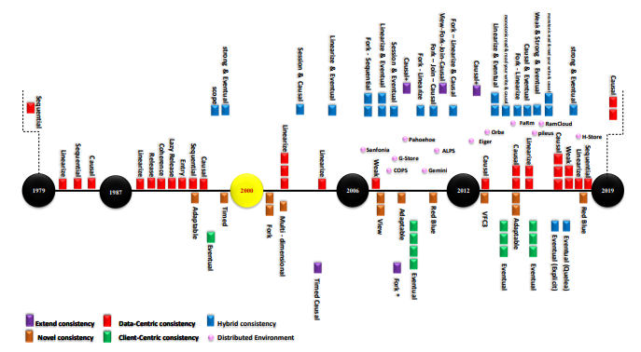
Evolution of Consistency Models

Slide 26
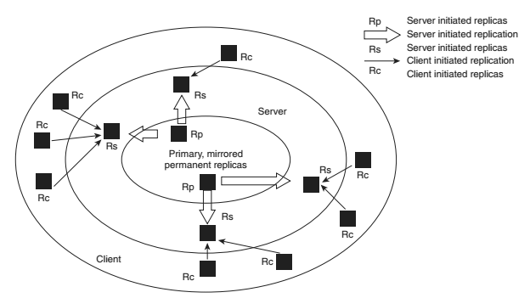
Replicas
Access latency
Load balancing
The logical organization of different kinds of copies of a data store into three concentric rings.

Slide 27
Permanent Replicas
Initial set of replicas
– Other replicas can be created from them
– Small and static set
• Example: Web site horizontal distribution
1. Replicate Web site on a limited number of machines on a LAN
– Distribute request in round-robin
2. Replicate Web site on a limited number of machines on a WAN (mirroring)
– Clients choose which sites to talk to

Slide 28
Server-Initiated Replicas (1)
Dynamically created at the request of the owner of the DS
• Example: push-caches
– Owners: web owners for CNN, Yahoo etc.
– Web hosting servers can dynamically create replicas close to the demanding client
• Need dynamic policy to create and delete replicas
• One is to keep track of Web page hits
– Keep a counter and access-origin list for each page

Slide 29
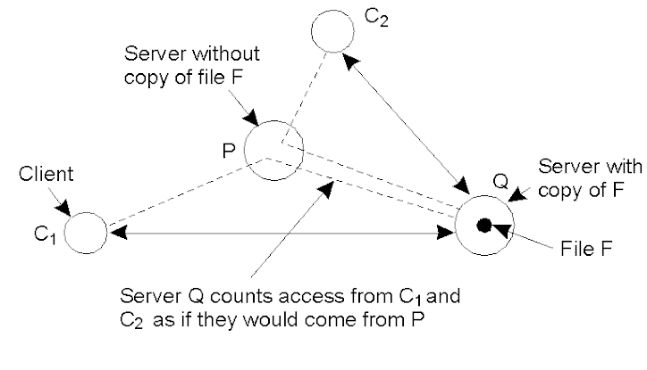
Server-Initiated Replicas
Reduce load on servers
Specific files could be migrated.
Counting access requests from different clients.

Slide 30
Client-Initiated Replicas
These are caches
–Temporary storage (expire fast)
• Managed by clients
• Cache hit: return data from cache
• Cache miss: load copy from original server
• Kept on the client machine, or on the same LAN
• Multi-level caches

Slide 31
Replica Placement
Replication Models
Master−Slave: Slaves are read-only, updates only in master, slaves only synchronize with master.
2. Client−Server: Just like master−slave model, but updates can happen in any slave replica too. Which are first pushed to server, and then to others.
3. Peer–to–Peer: All replicas are of equal importance and are peer. Any replica can synchronize with any other besides any replica can propagate the update. All peers should have all the information
Replica Consistency
Optimistic:
Pessimistic:

Slide 32
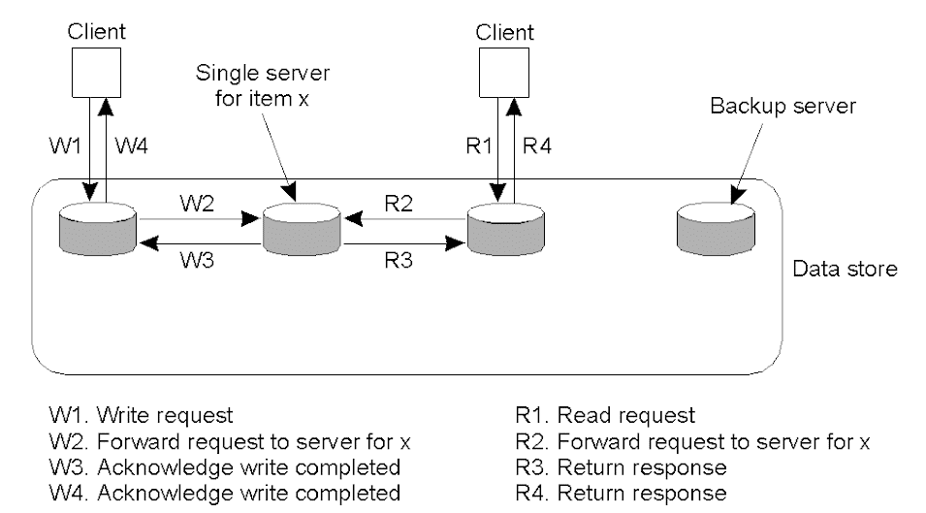
Consistency Protocols: Remote-Write Protocols (1)
Primary –based : data item x is associated with a primary responsible for co-ord. writes
Primary-based remote-write protocol with a fixed server to which all read and write operations are forwarded.

Slide 33
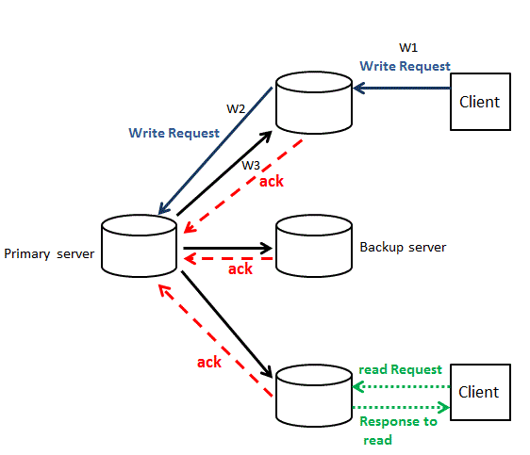
Primary-Based replication Protocol

Slide 34
Primary-Based Remote-Write Protocols (cont.)
Replicated: primary-backup remote write protocol
–Primary copy and backups for each data item
–Read from local copy
–Write to the (remote) primary server
–Update backups
• Blocking vs. Non-Blocking update

Slide 35
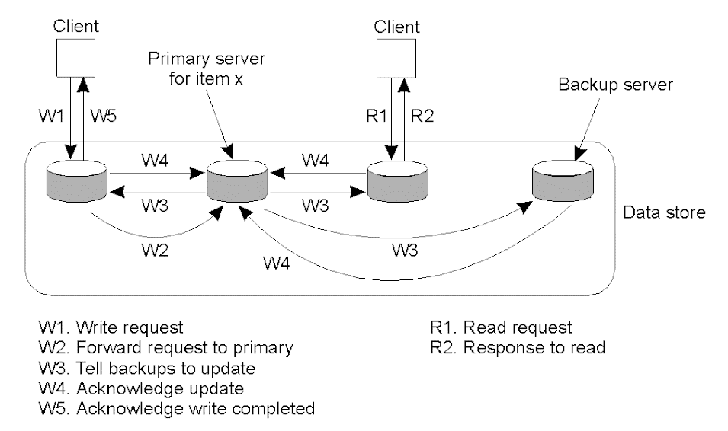
Remote/Replicated -Write Protocols
The principle of primary-backup protocol.

Slide 36
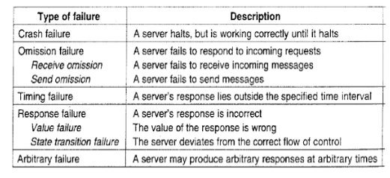
Fault Tolerance
OS Crash
deadlock
client-server connection failure,
listen thread is not available
buffer size is not adequate
send buffer overflows
even link failure
Providing data too soon or late
Black hole routers
Failure Detection: Synchronous /Asynchronous

Slide 37
Failure Detection: Synchronous /Asynchronous
Fail-stop failures refer to crash failures that can be reliably detected. This may occur when assuming non-faulty communication links and the failure detecting process P can place a worst-case delay (Final Timeout) on responses from Q.
Fail-noisy failures are like fail-stop failures, except that P only eventually comes to the correct conclusion that Q has crashed. This means that there may be some a priori unknown time in which P’s detections of the behaviour of Q are unreliable. (Incremental Timeout-Final Timeout)
• When dealing with fail-silent failures, you assume that communication links are non-faulty, but the process P cannot distinguish crash failures from omission failures.
Fail-safe failures cover the case of dealing with arbitrary failures by the process Q, yet these failures are benign, i.e. they cannot do any harm.
• Finally, when dealing with fail-arbitrary failures, Q may fail in any possible way; failures may be unobservable in addition to being harmful to the otherwise correct behaviour of other processes. Clearly, the worst situation is that in which you have to deal with fail-arbitrary failures.

Slide 38
Failure Masking
1. Information redundancy:, parity, checksums, Hamming codes, forward error correction (FEC) codes, etc.
2. Time redundancy: An additional time that is used to deliver the service of a system or multiple executions of an operation. For example, retransmission handling in networks, or if a transaction aborts, then rollback till the closest checkpoint restarts.
3. Physical redundancy For example, extra processes can be added to a system so that if a small number of them get crashed, the system can still function correctly.
Even in biology (mammals have two eyes, two ears, two lungs, etc.), aircraft (747s have four engines but can fly on three), and sports (multiple referees in case one misses an event). Another example is Hadoop Distributed File System (HDFS)

Slide 39
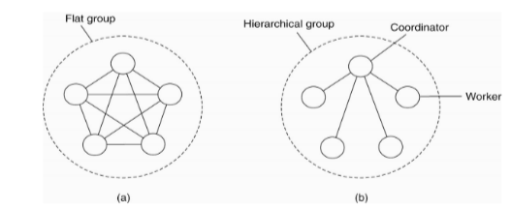
Resilience by Process Groups
Group Organization and Management

Slide 40
Byzantine agreement problem (Byzantine Generals Problem)
Assumptions and Goals:
Assume that processes are synchronous, messages are unicast while preserving ordering, and communication delay is bounded.
Assume N processes, where each process i will provide a value vi to others.
Goal- Let each process construct a vector V of length N, such that
if process i is non-faulty, V [i] = vi
ELSE V [i] is undefined/unknown
Assume that there are at most k faulty processes.

Slide 41
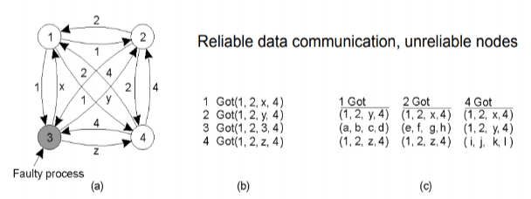
Byzantine agreement problem (Byzantine Generals Problem)
Assumptions and Goals:
Assume that processes are synchronous, messages are unicast while preserving ordering, and communication delay is bounded.
Assume N processes, where each process i will provide a value vi to others.
Goal- Let each process construct a vector V of length N, such that
if process i is non-faulty, V [i] = vi
ELSE V [i] is undefined/unknown
Assume that there are at most k faulty processes.

Slide 42
(a) Each process sends its value to others
(b) The vectors, that each process assembles, are based on (a)
(c) The vectors that each process receives in step 3
The generals announce their troop strengths (for example, in units of 1-k soldiers) to the other members of a group by sending a message.
The vectors V, that each general assembles, are based on (a), each general knows its own strength. They then send their vectors to all the other generals.
Each general receives vectors in step 3. It is clear to all that General 3 is the traitor. In each ‘column’, the majority value is assumed to be correct.

Slide 43
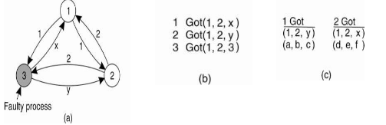

Slide 44
BFT in Block Chain Bitcoin
A blockchain is a chain of time stamped data blocks that contain transactions with each block hashed to the previous one. This provides immutability to a blockchain. These blocks on a chain can only be added using a distributed consensus algorithm and also one should be able to identify the correct chain.
Consensus algorithms using a modified version of Proof of Work (PoW), created by Satoshi Nakamoto for Bitcoin became almost the first (BFT) algorithm which was open and distributed peer-to-peer (P2P) network that utilises a distributed network of anonymous nodes that are free to join and leave,based on the concept of “Mining” as compared to a traditional semi-closed group of nodes, deploying Practical Byzantine Fault Tolerance (pBFT) voting-based algorithm.
PoW was designed for two things:
to ensure the next blockchain is the one and only version of the truth and
to keep powerful adversaries from derailing a system and forking a chain.

Slide 45
PoW algorithm is not 100% tolerant to Byzantine faults, but due to the cost-intensive mining process and the underlying cryptographic techniques, it has proven to be one of the most secure and reliable implementations for blockchain networks.
Nakamoto Consensus can be broken down into roughly four parts which are listed as follows:
Proof of Work (PoW)
Block selection
Scarcity
Incentive structure
To “Mine” a page of the cryptocurrency ledger, known as a ‘block’, a node must work hard and figure out a cryptographic puzzle that is predicated on incrementing a nonce in the block until the correct value that represents the block’s hash and required zero bits for the beginning of the nonce is reached. Once the equation is solved, the node wins the round of the lottery and is rewarded with currency, referred to as a ‘block reward’ (cryptocurrency). The nodes those who take part in the computation are called ‘miners. If one miner gets a different answer to the puzzle compared to others, their answers will be rejected. As it costs a lot of electricity and computational power to mine for a block reward, lying is prevented as it will not pay off. Instead, miners do work, have proof of the work, and are rewarded.
This mined block is then propagated by the miner across a network to the other mining nodes to validate the block and then add the block to the longest chain. The validation rules ensure that the proposed blocks have the requisite computational work performed in order to be accepted. Further, as long as the longest chain and majority of the network’s hashing power is controlled by honest nodes, the honest chain will grow the fastest and outpace competing chains. If all the transactions within the block are not double spent (a type of an attack where the given set of coins is spent in more than one transaction), and the block is added to the longest chain.
A scarcity in Bitcoin is based on this premise by limiting the total number of Bitcoin that will be mined to 21 million. Additionally, Bitcoin can only be injected into a system through the mining process and it follows a deflationary scheme where the block reward is halved every 2,10,000 blocks (~4 years). Miners are incentivised to validate and secure a network honestly, as the reward that they receive for mining a block is Bitcoin. If the value of Bitcoin drops or the network becomes compromised.
Other rewarding mechanism other than mining are Proof of Stake (PoS), Delegated Proof of Stake (dPoS) and Proof of Importance (PoI), etc.
Please check as the sentences is incomplete without the “then”part.
PoW was designed for two things:
to ensure the next blockchain is the one and only version of the truth and
to keep powerful adversaries from derailing a system and forking a chain.
PoW algorithm is not 100% tolerant to Byzantine faults, but due to the cost-intensive mining process and the underlying cryptographic techniques, it has proven to be one of the most secure and reliable implementations for blockchain networks.

Slide 46
Nakamoto Consensus can be broken down into roughly four parts which are listed as follows:
Block selection : To “Mine” a page of the cryptocurrency ledger, known as a ‘block’, a node must work hard and figure out a cryptographic puzzle that is predicated on incrementing a nonce in the block until the correct value that represents the block’s hash and required zero bits for the beginning of the nonce is reached
Incentive structure :Once the equation is solved, the node wins the round of the lottery and is rewarded with currency, referred to as a ‘block reward’ (cryptocurrency). The nodes those who take part in the computation are called ‘miners. If one miner gets a different answer to the puzzle compared to others, their answers will be rejected
Proof of Work (PoW): As it costs a lot of electricity and computational power to mine for a block reward, lying is prevented as it will not pay off. Instead, miners do work, have proof of the work, and are rewarded.
Scarcity: A scarcity in Bitcoin is based on this premise by limiting the total number of Bitcoin that will be mined to 21 million. Additionally, Bitcoin can only be injected into a system through the mining process and it follows a deflationary scheme where the block reward is halved every 2,10,000 blocks (~4 years).
Incentive structure :Once the equation is solved, the node wins the round of the lottery and is rewarded with currency, referred to as a ‘block reward’ (cryptocurrency). The nodes those who take part in the computation are called ‘miners. If one miner gets a different answer to the puzzle compared to others, their answers will be rejected
Miners are incentivized to validate and secure a network honestly, as the reward that they receive for mining a block is Bitcoin. If the value of Bitcoin drops or the network becomes compromised.

Slide 47
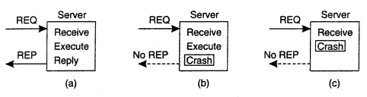
RPC Semantics in the Presence of Failure

Slide 48
Server Management
Server States
Stateful
Stateless
Server Creation Semantics
Instance - Per - Call
Instance - Per – Session
Persistent Servers

Slide 49
Parameter Passing
Call – by – value
Call by Reference
Call Semantics
May- be
Last-one call
Last – of –many
At – least once
Exactly once

Slide 50
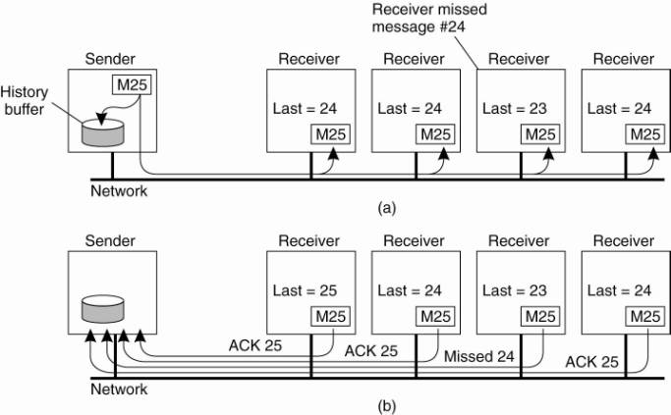
Reliable group communication

Slide 51
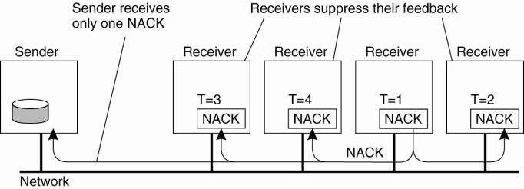

Slide 52
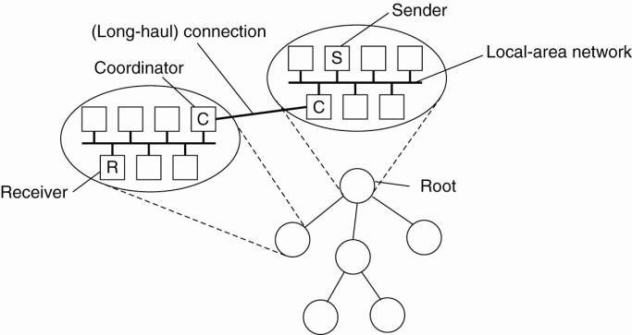
Hierarchical feedback control

Slide 53
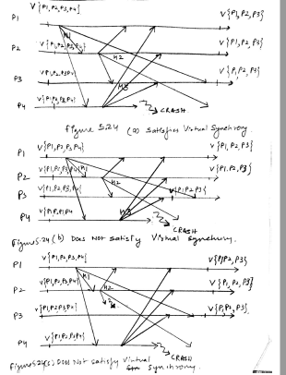
Virtual Synchrony View synchrony

Slide 55
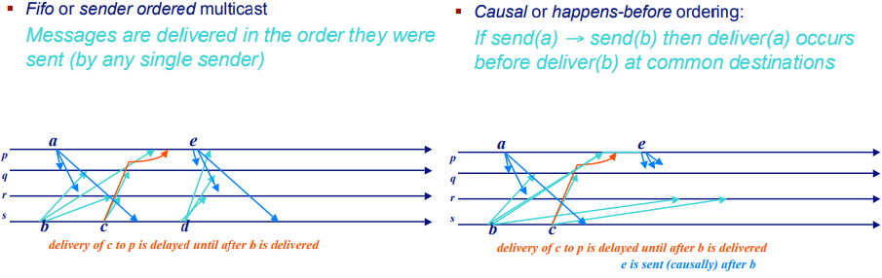
Message Ordering

Slide 56
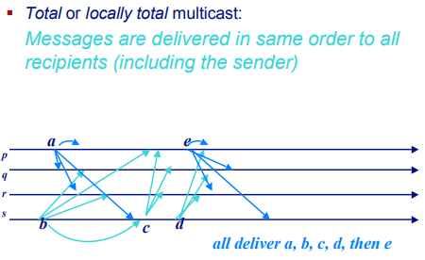
Message Ordering

Slide 57
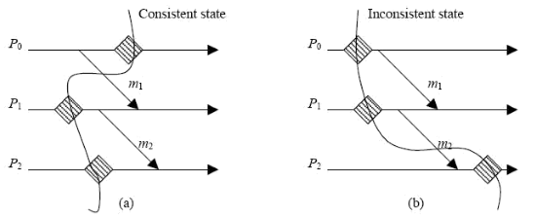
Consistent Cut: Global state

Slide 58
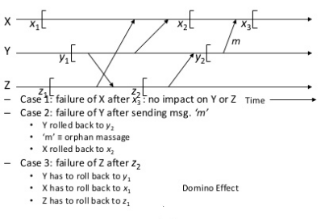
Dominos Effect : Orphan management

